Slide 1
Advanced Lane Line Detection

Slide 2
Pipeline
Use color transforms and gradient methods to create a binary image.
Apply a region mask.
Apply a perspective transform to create a “bird’s-eye view of the image.
Fit a curve to each lane line.
Create a color mask, unwarp the color mask.
Draw the color mask on the original image.

Slide 3
Color Transforms and Gradient Techniques
Grayscale
Sobel X
Red Color Channel
S Color Channel (HLS space)
L Color Channel (HLS space)

Slide 4
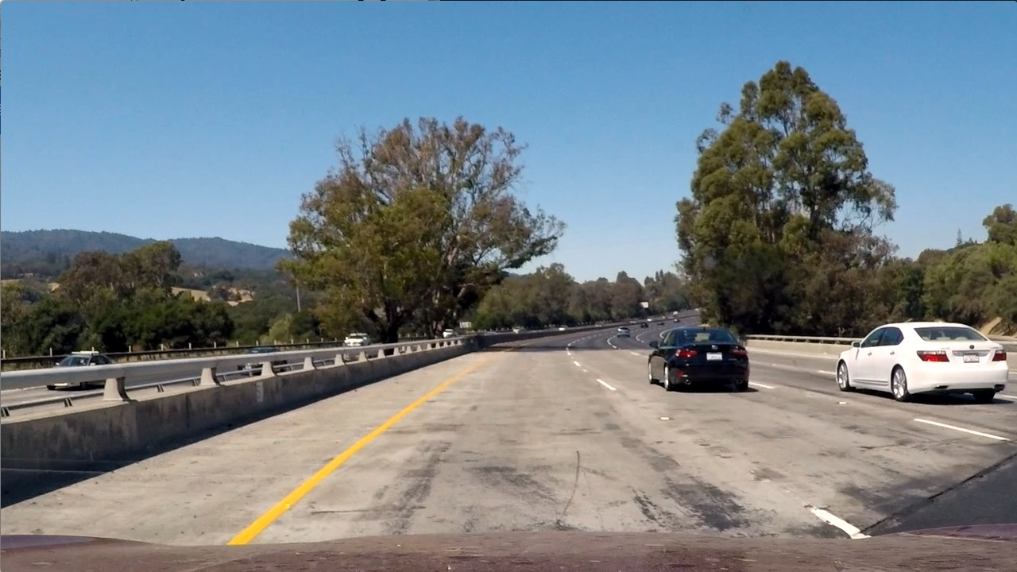
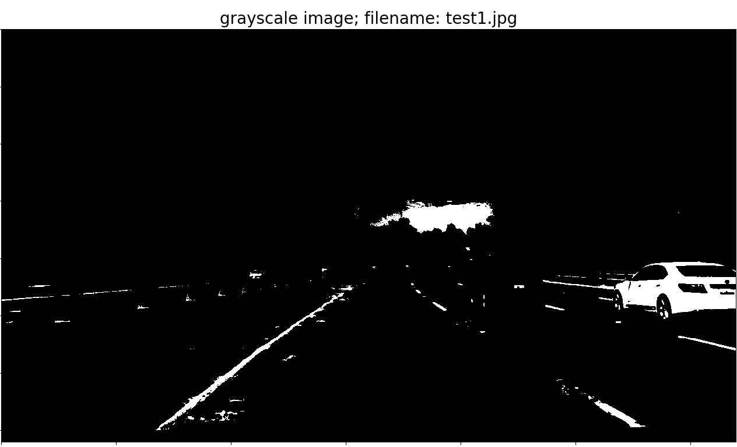
Thresholded Grayscale: test1.jpg

Slide 5
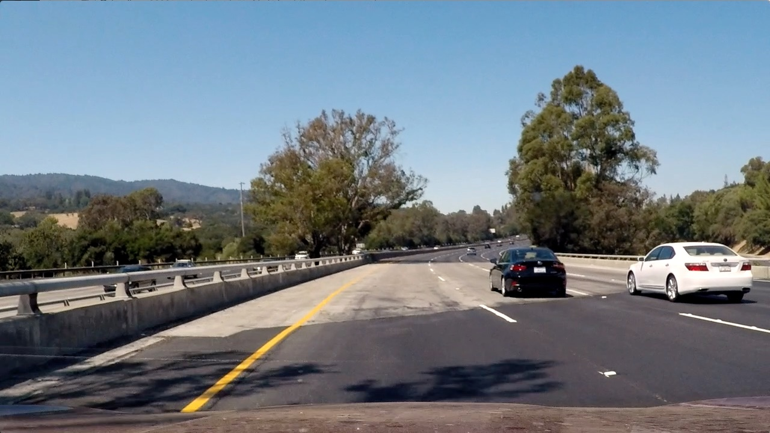
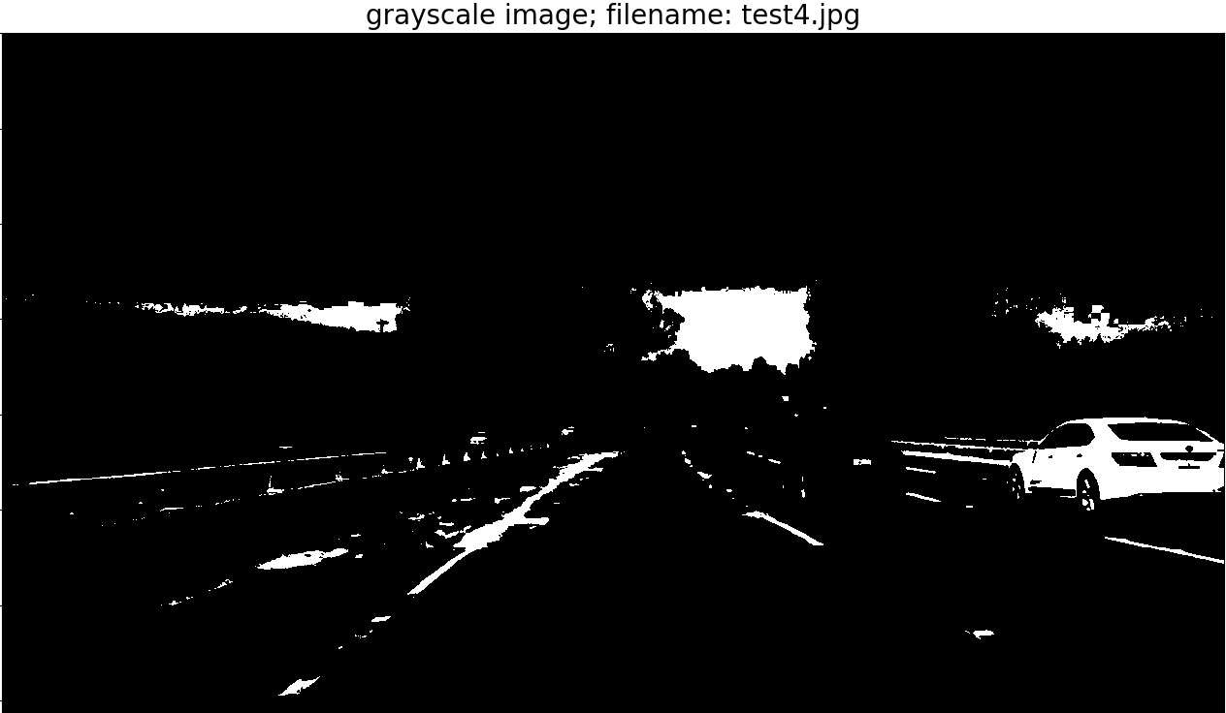
Thresholded Grayscale: test4.jpg

Slide 6
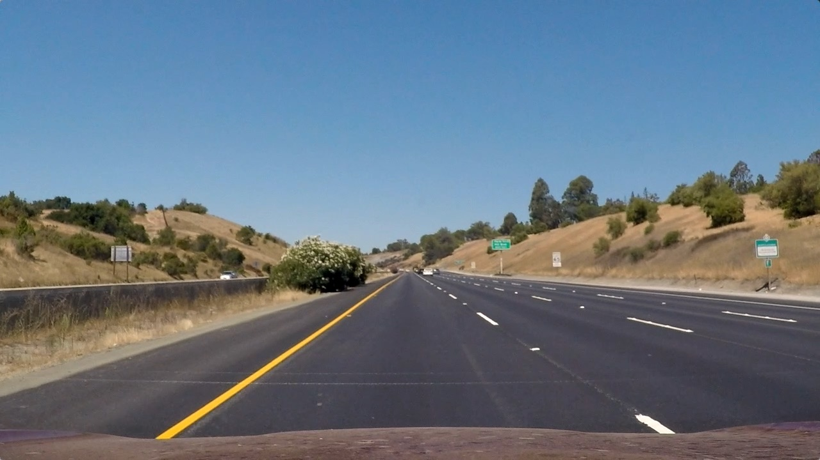
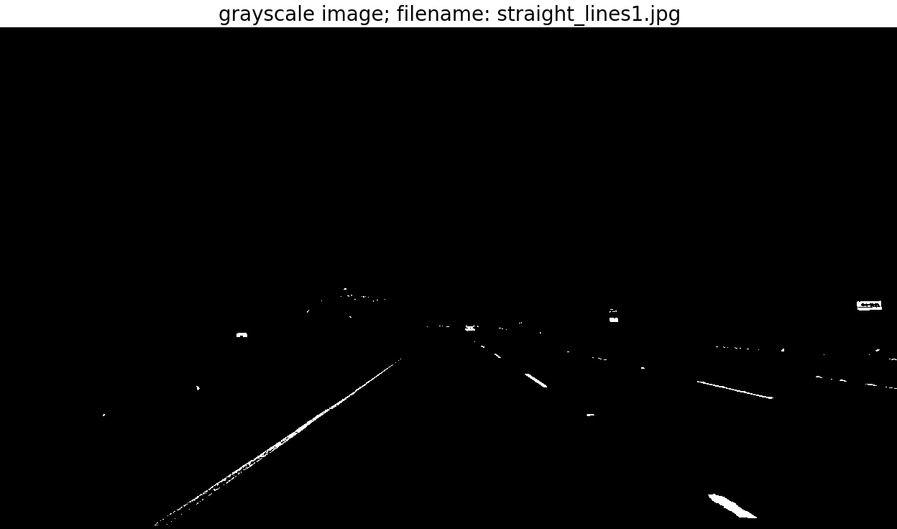
Thresholded Grayscale: straight lines.jpg

Slide 7
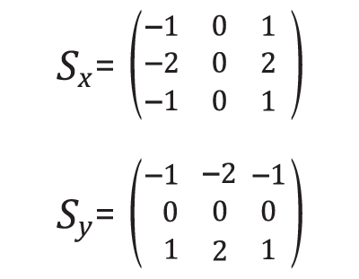
Sobel Operator
Slide the center pixel of the small matrix over each pixel in the image.
Pairwise multiply the pixels, then take the sum.
The sum represents the magnitude of the gradient in either the X or Y direction.

Slide 8
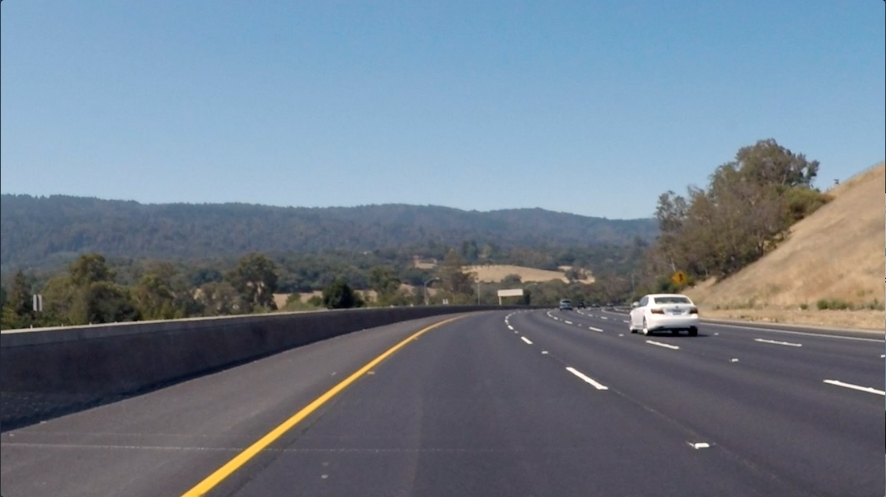
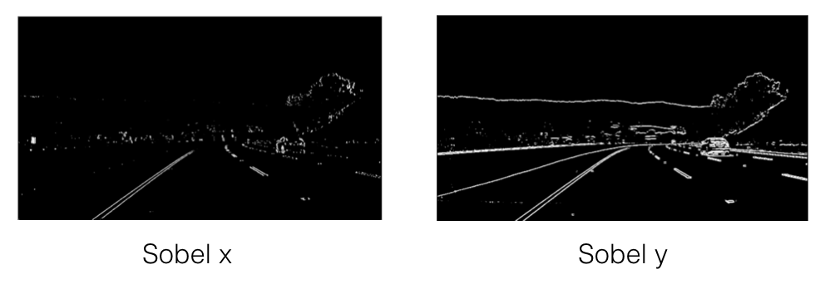
Sobel X vs Sobel Y (Thresholded)

Slide 9
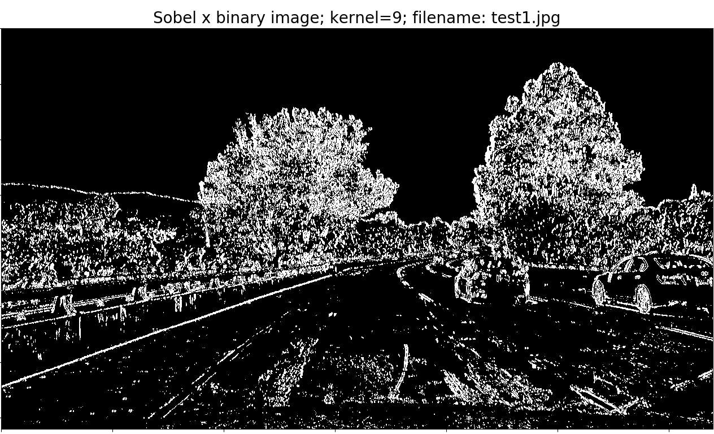
Sobel X test1.jpg

Slide 10
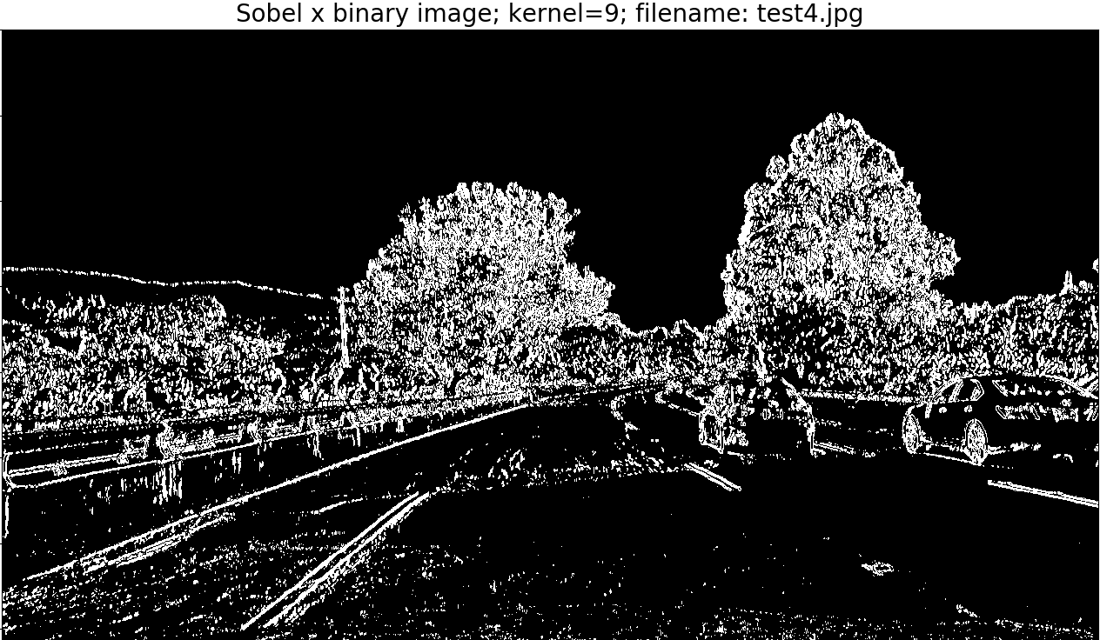
Sobel X test4.jpg

Slide 11
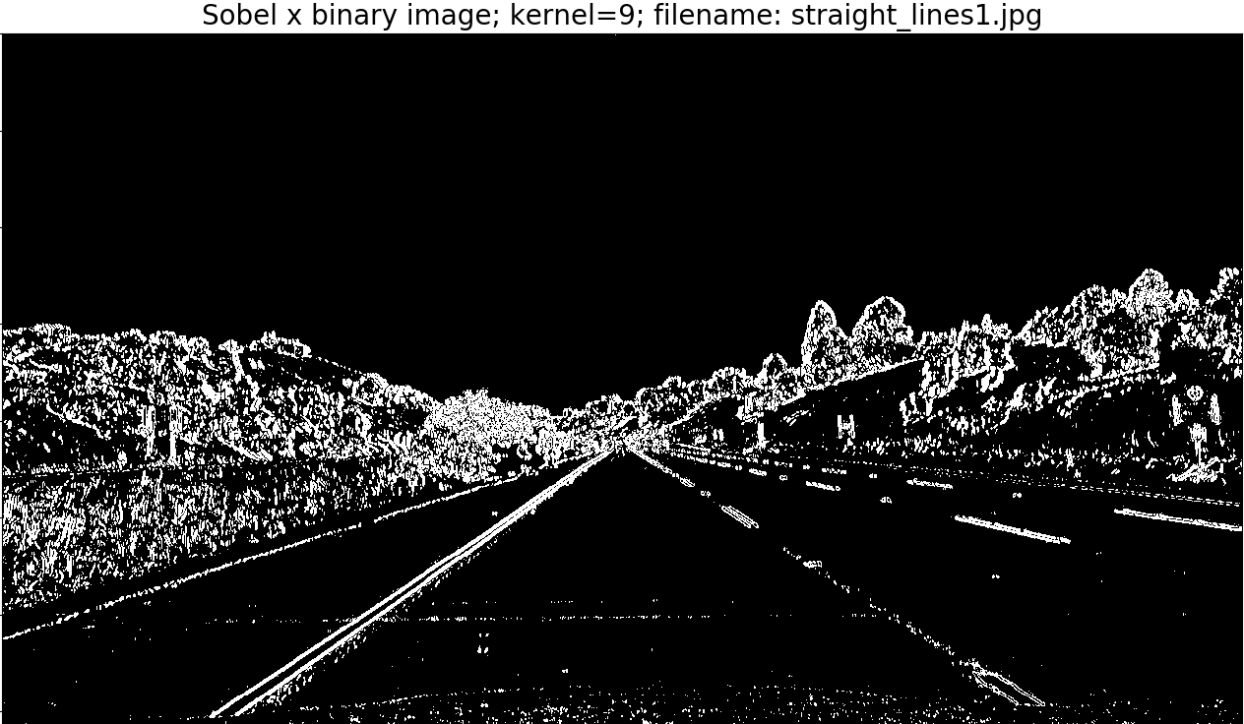
Sobel X straight lines.jpg

Slide 12
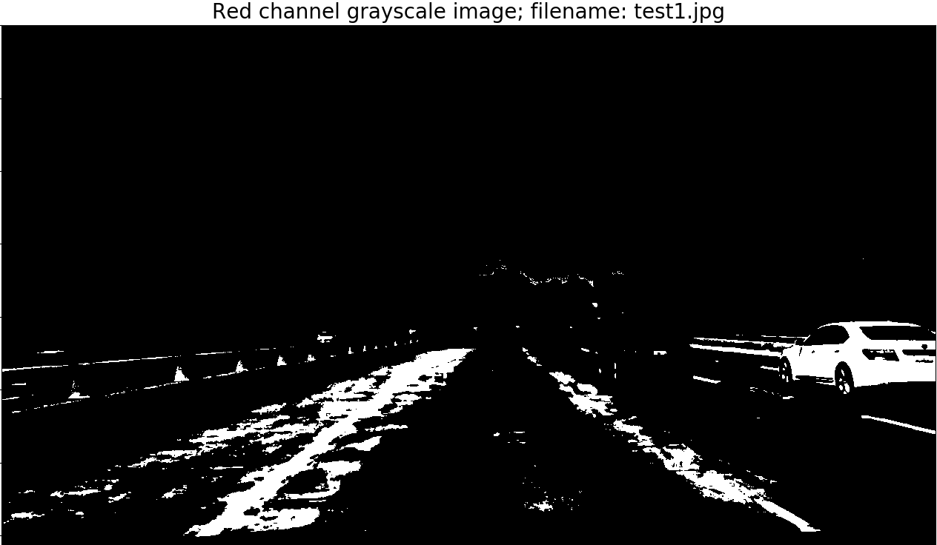
Red Channel test1.jpg

Slide 13
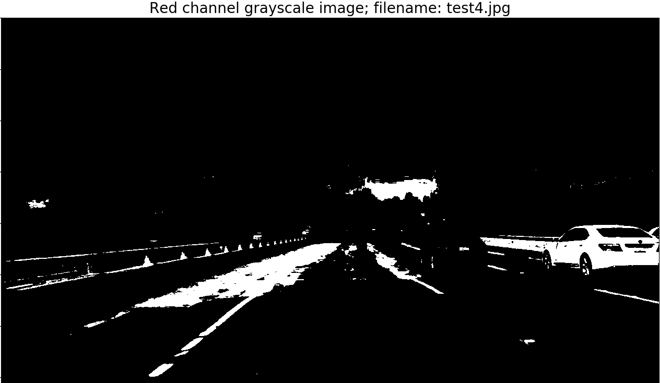
Red Channel test4.jpg

Slide 14
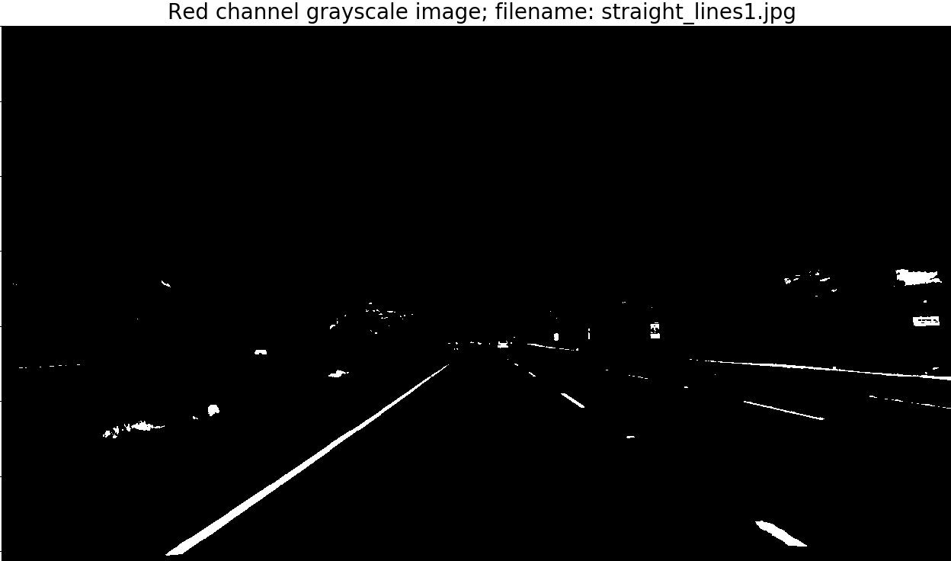
Red Channel straight lines.jpg

Slide 15
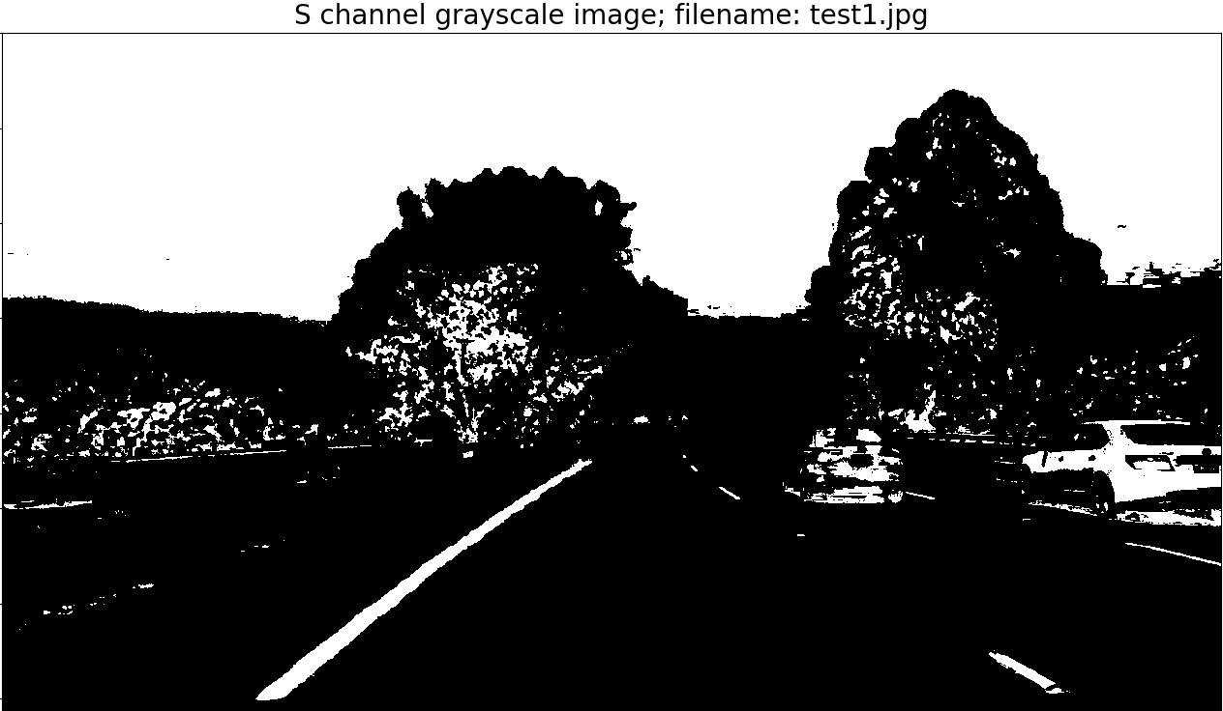
S Channel test1.jpg

Slide 16
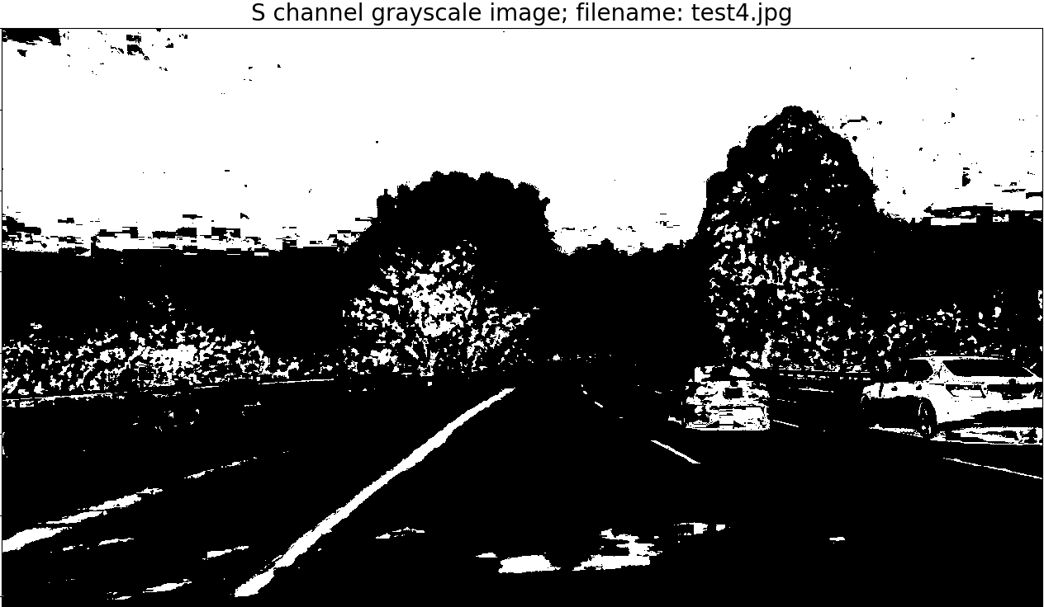
S Channel test4.jpg

Slide 17
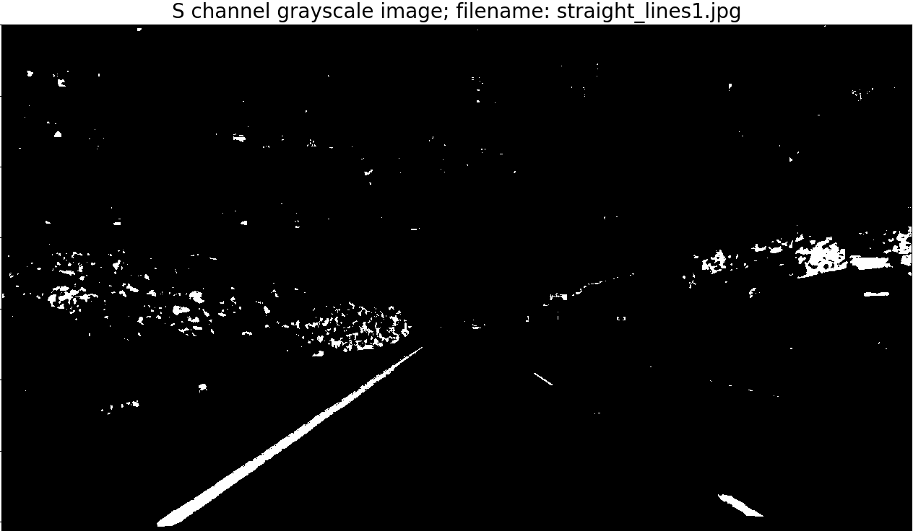
S Channel straight lines.jpg

Slide 18
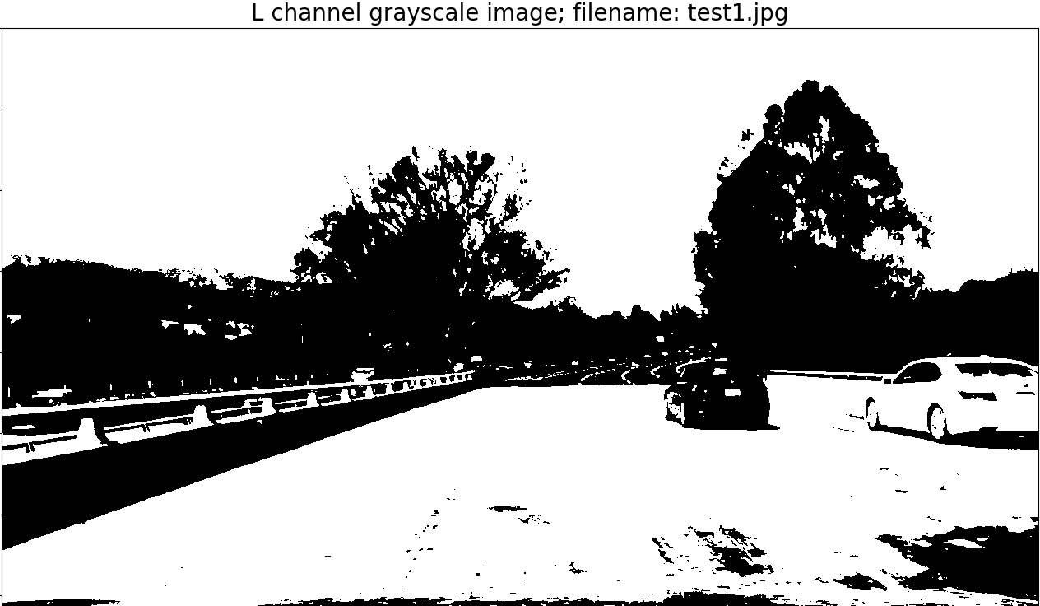
L Channel test1.jpg

Slide 19
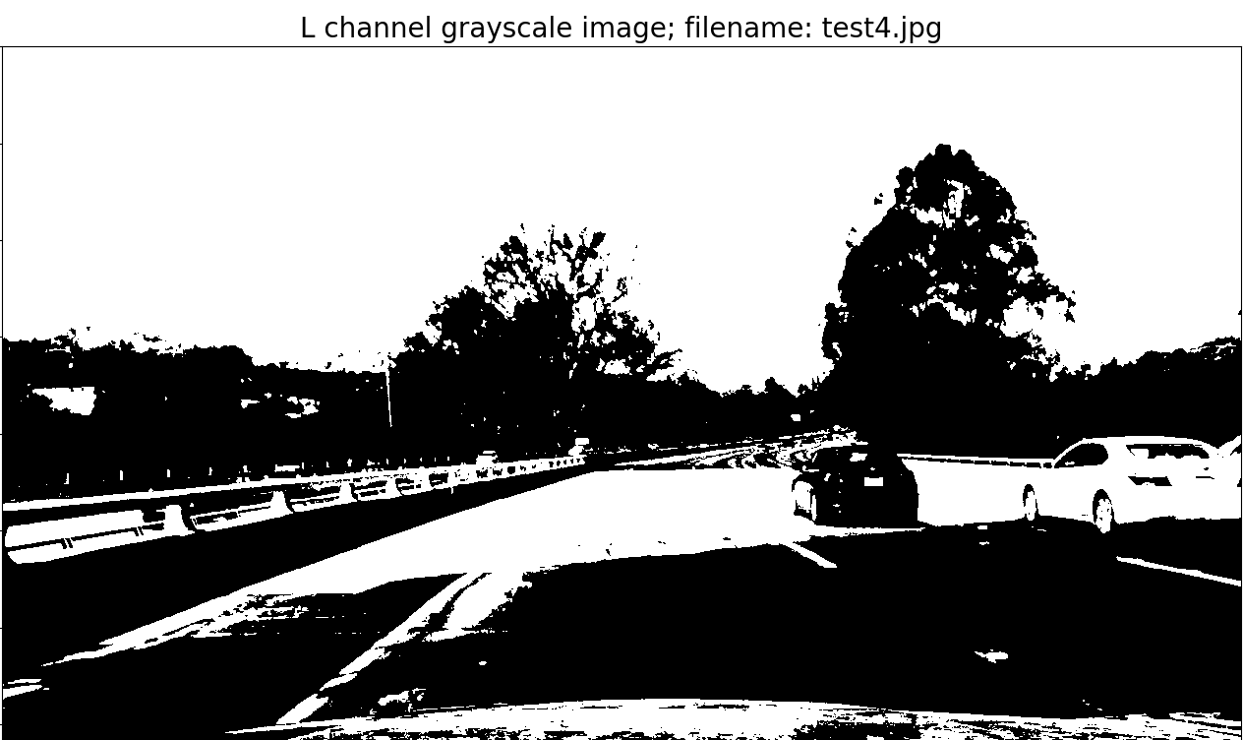
L Channel test4.jpg

Slide 20
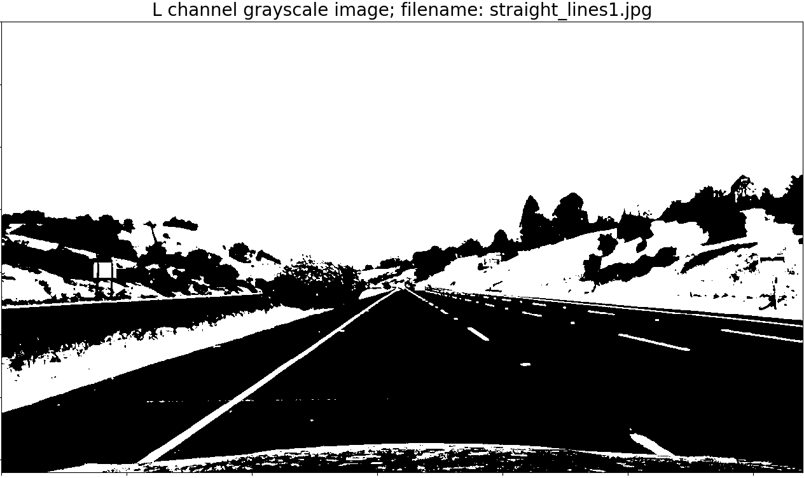
L Channel straight lines.jpg

Slide 21
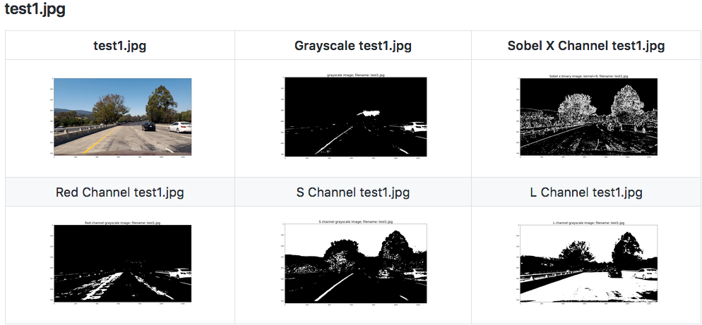
Combining Color Channels (S & R) | (L & G)

Slide 22
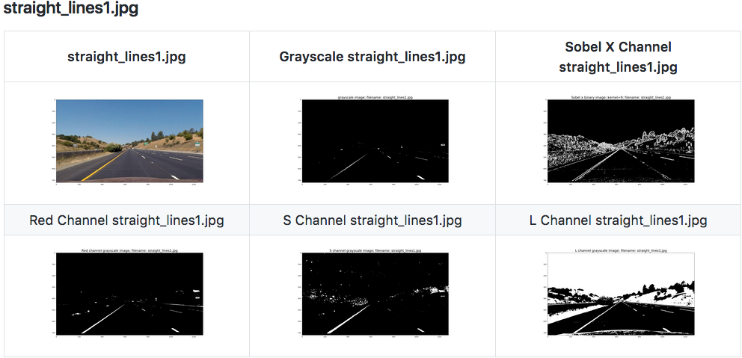
Combining Color Channels (S & R) | (L & G)

Slide 23
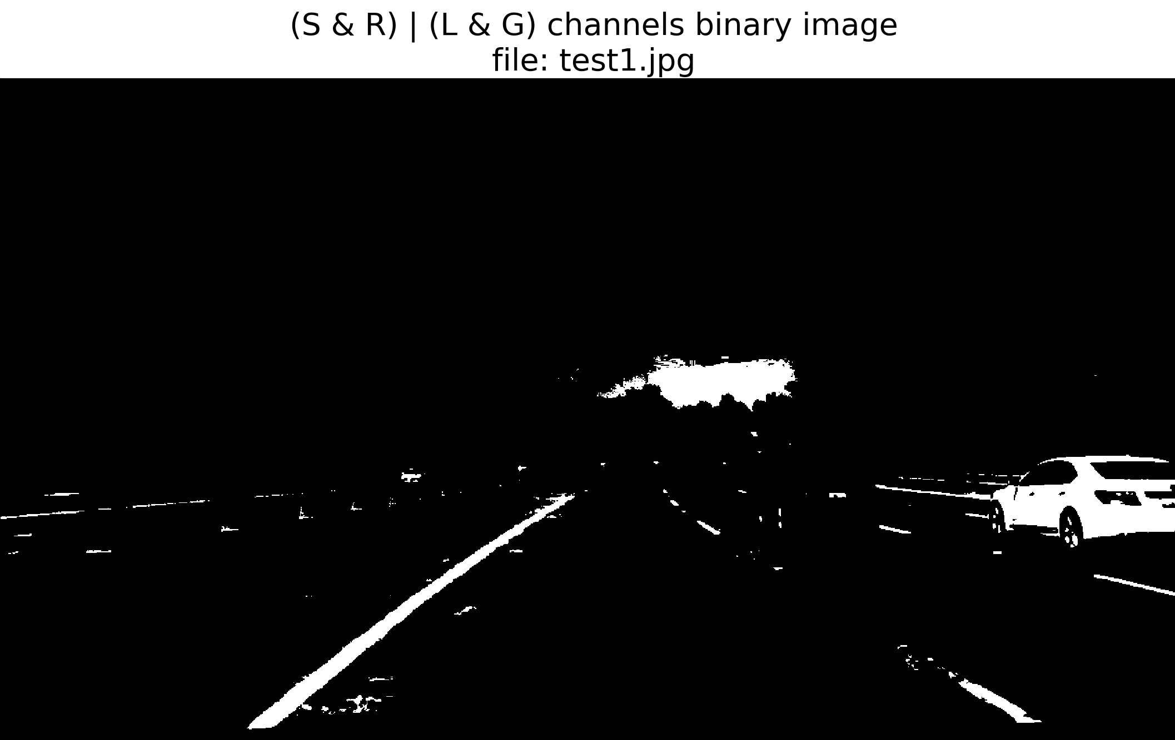
(S & R) | (L & G) test1.jpg

Slide 24
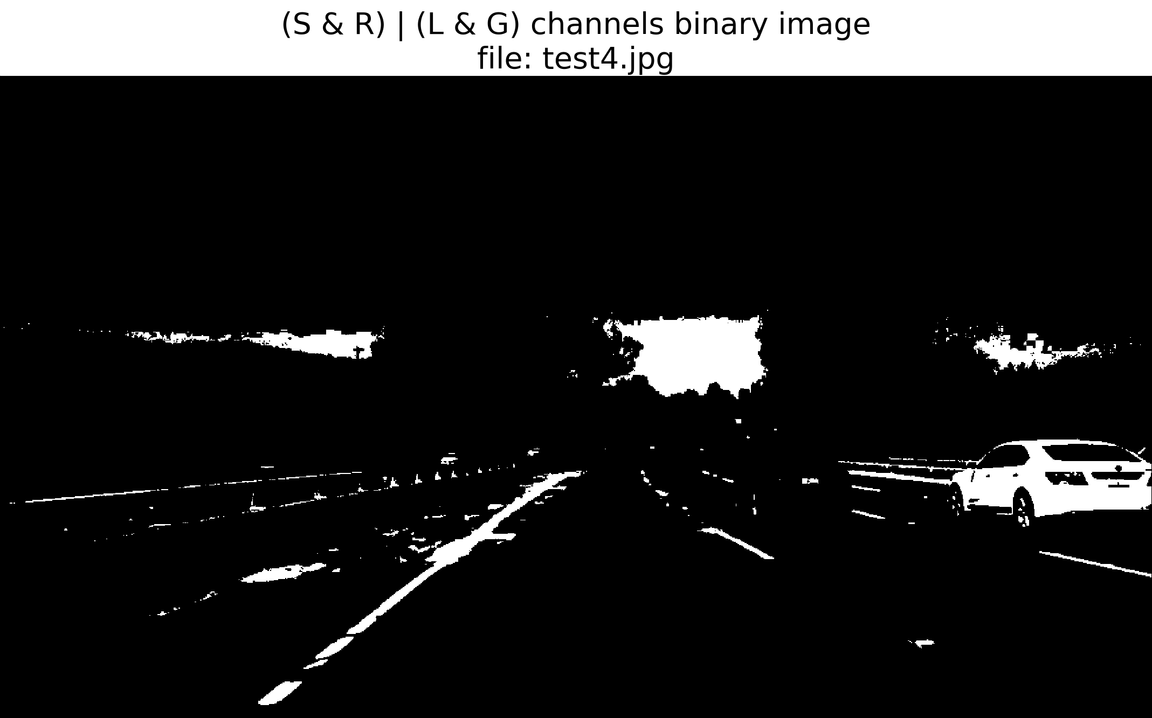
(S & R) | (L & G) test4.jpg

Slide 25
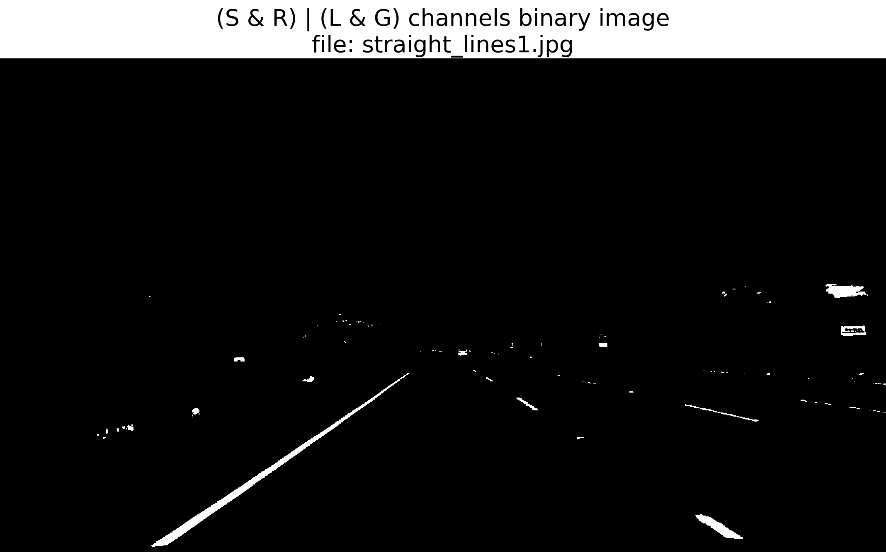
(S & R) | (L & G) straight lines.jpg

Slide 26
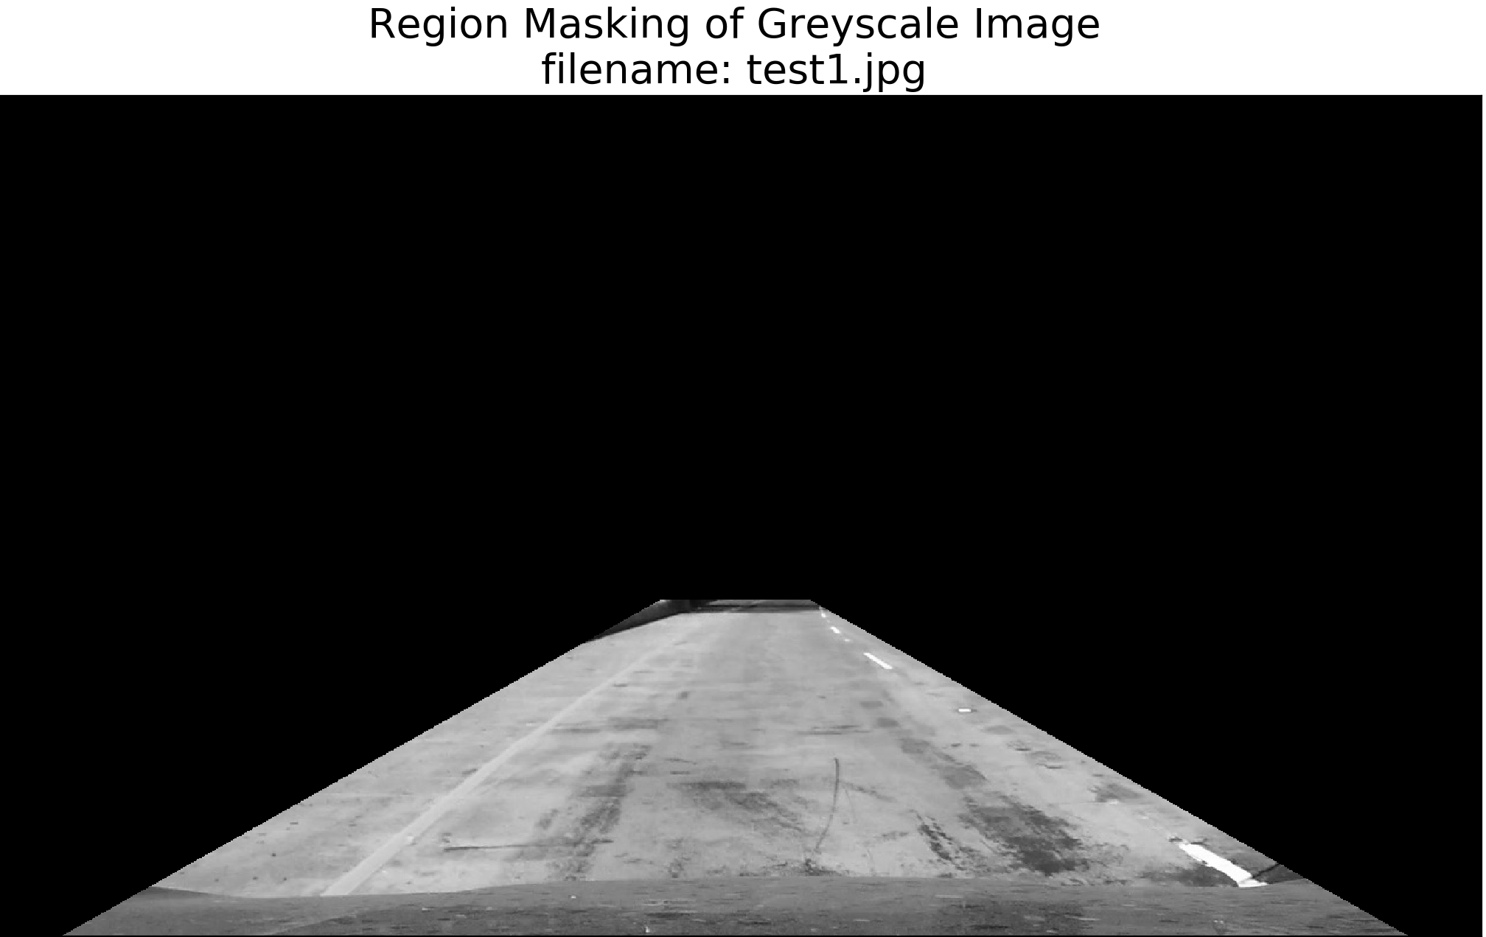
Region Mask

Slide 27
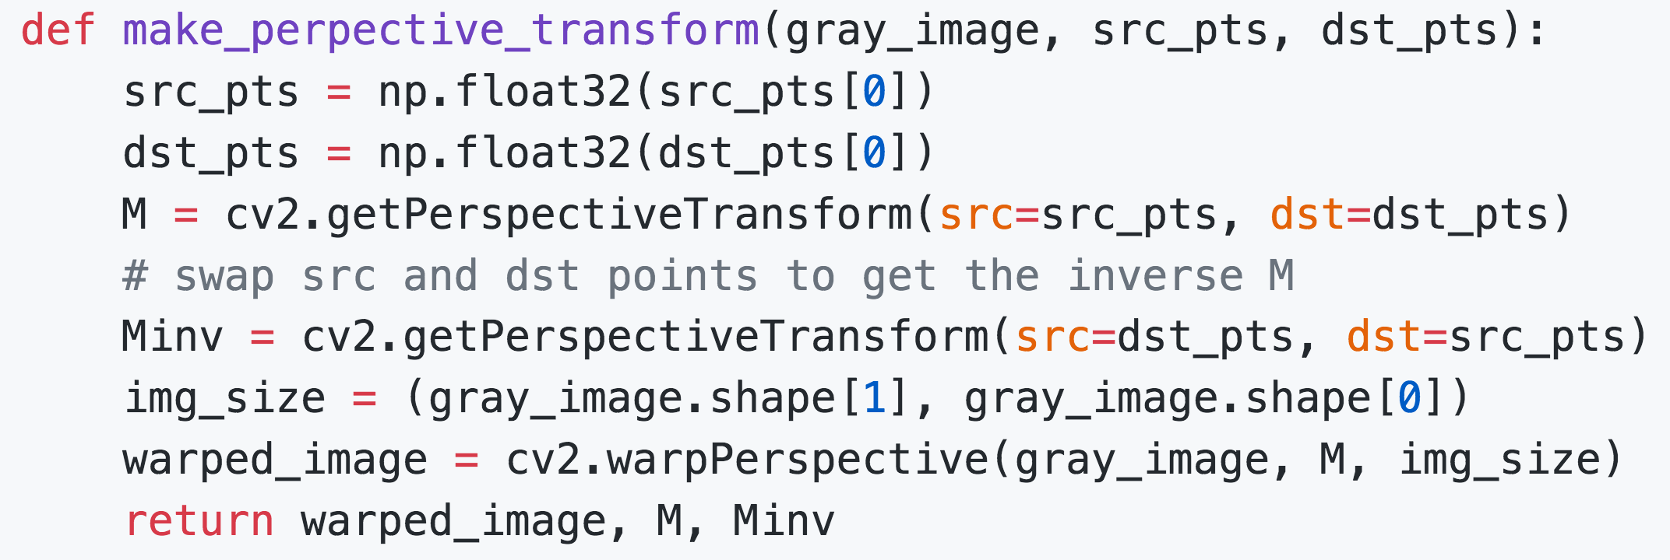
Perspective Transform
Warp the image so that the lane lines are roughly straight.

Slide 28
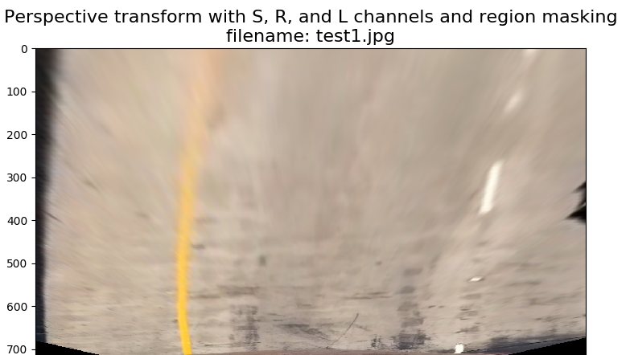
Perspective Transform: test1.jpg

Slide 29
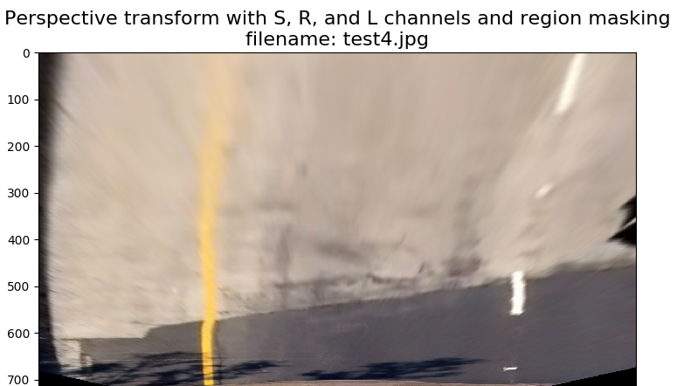
Perspective Transform: test4.jpg

Slide 30
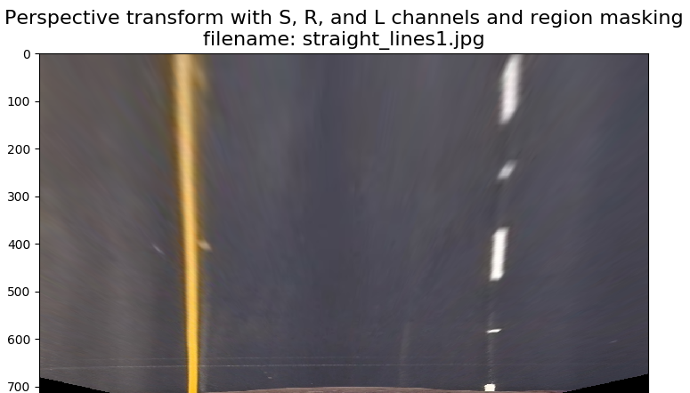
Perspective Transform: straight_lines1.jpg

Slide 31
Polynomial Fit (2nd order)
Split up the points into left lane and right lane points.
Fit a polynomial where x = f(y).
If the current polynomial is an ‘outlier’, it is discarded.
To determine an outlier:
Calculate statistics on the mean and standard deviation of differences in area between the current line and previous line.
If the difference between the areas of the current line and the previous line is greater than two standard deviations above the mean difference, the line is considered ’illegitimate’.
The accepted polynomial is added to a list of 5 legitimate polynomials.
The coefficients of the last 5 polynomials are averaged to obtain the current frame’s polynomial.

Slide 32
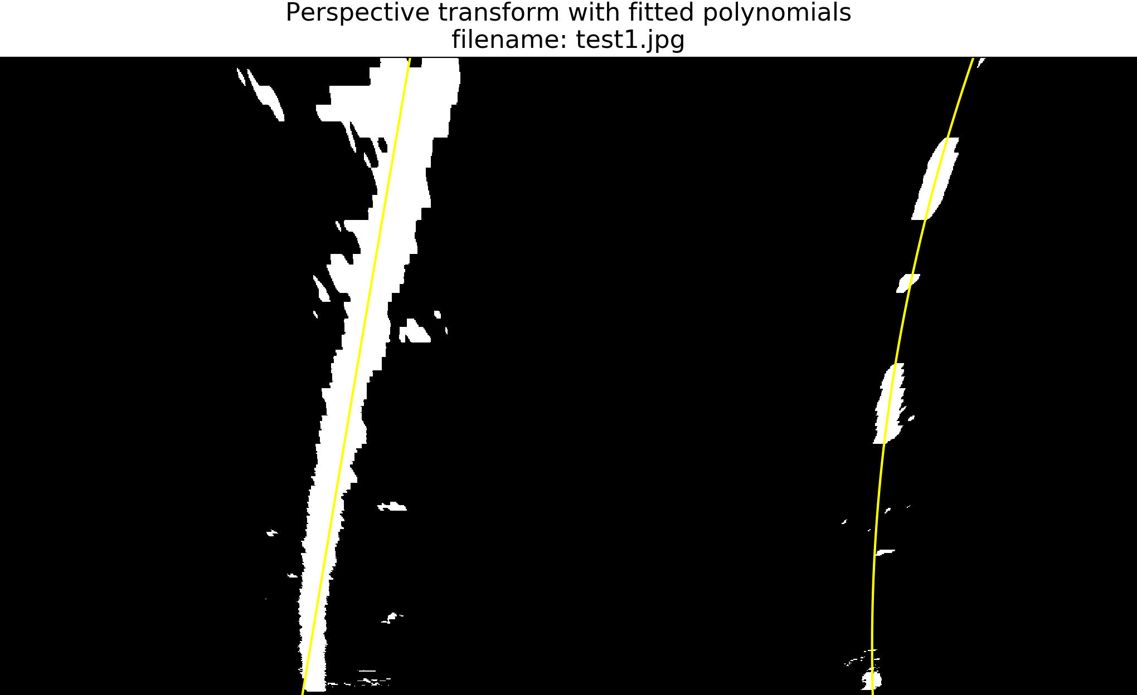
Polynomial Fit: test1.jpg (Binary)

Slide 33
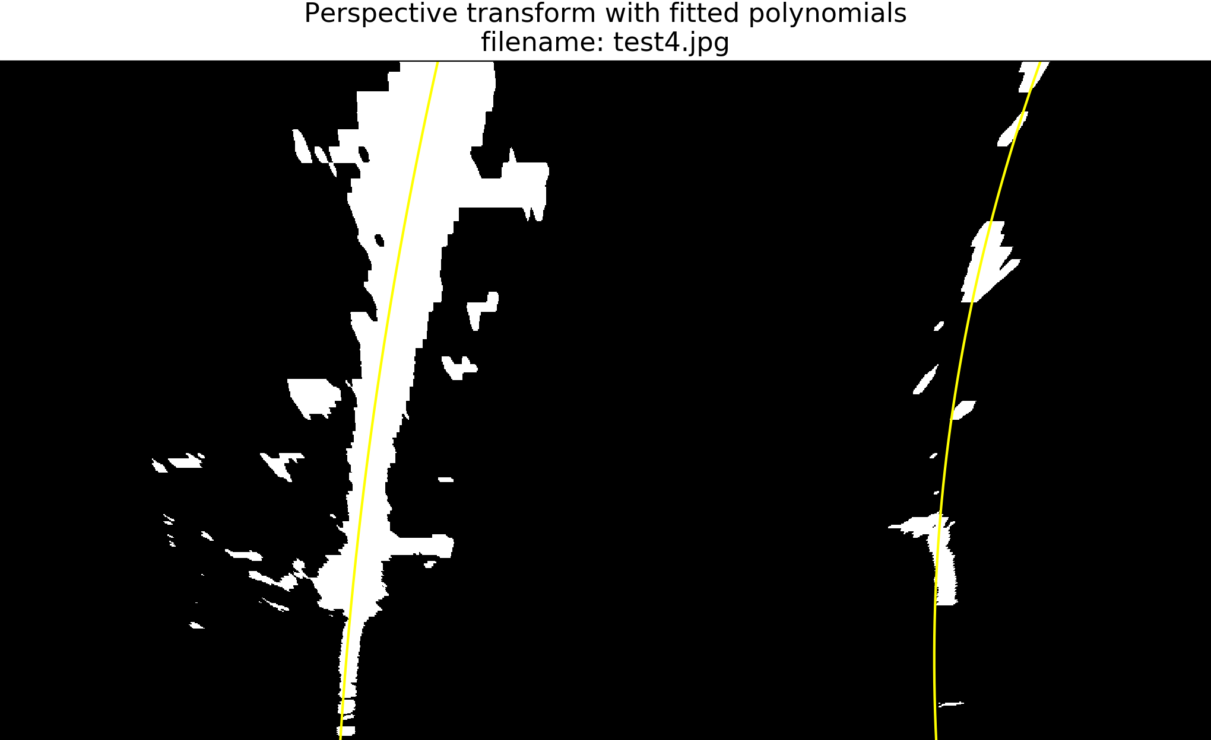
Polynomial Fit : test4.jpg (Binary)

Slide 34
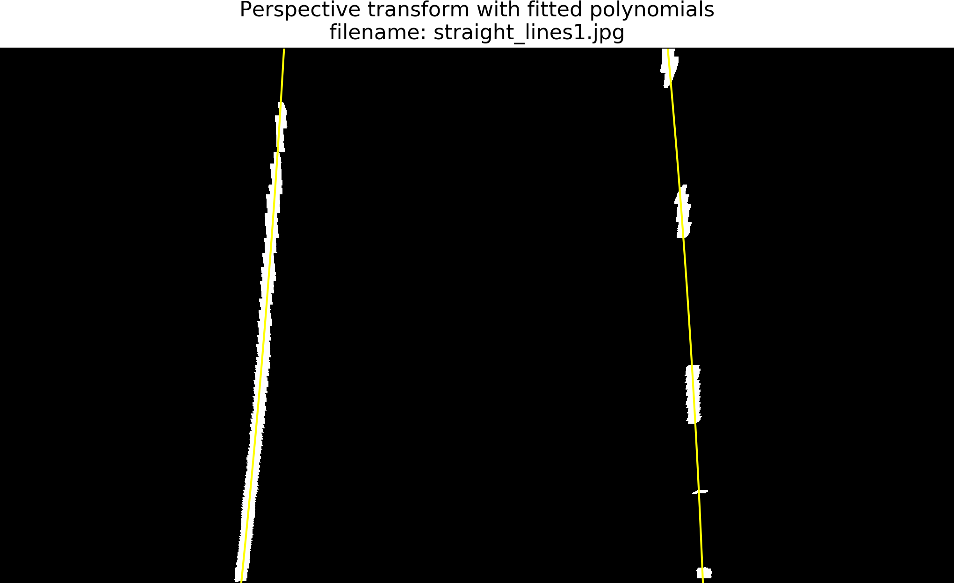
Polynomial Fit : straight_lines1.jpg (Binary)

Slide 35
Unwarping
Use the inverse perspective matrix to unwarp the canvas that has the lines and a coloring.
Color the undistorted image with the unwarped image.

Slide 36
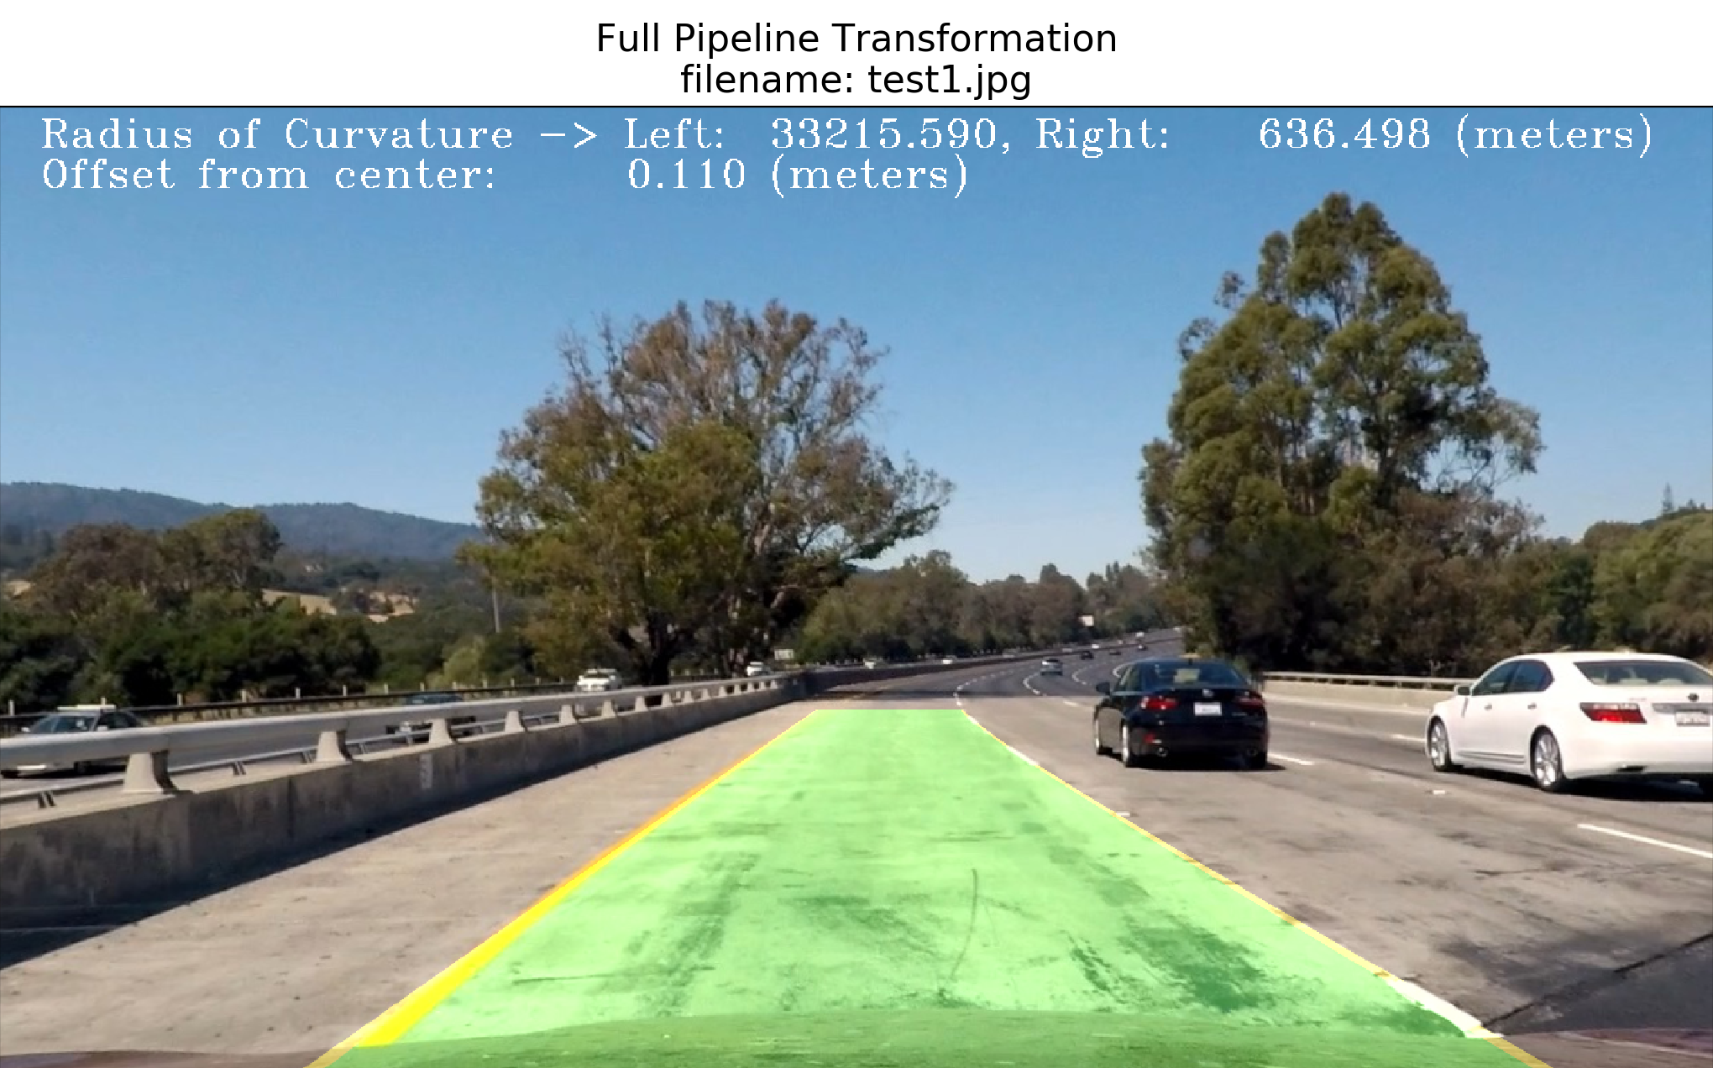
Full Pipeline (test1.jpg)

Slide 37
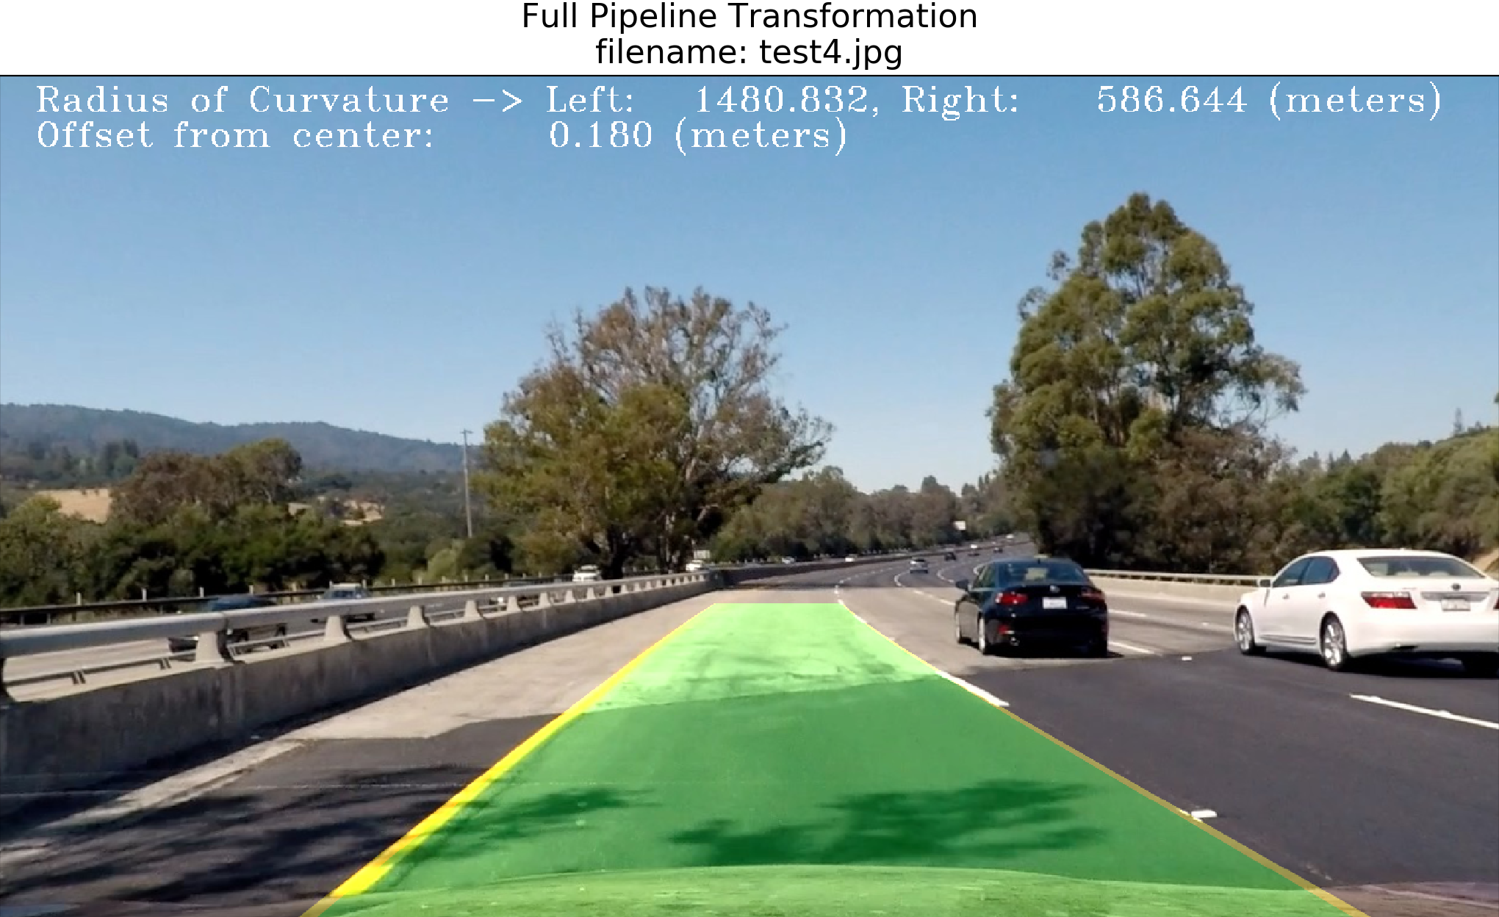
Full Pipeline (test4.jpg)

Slide 38
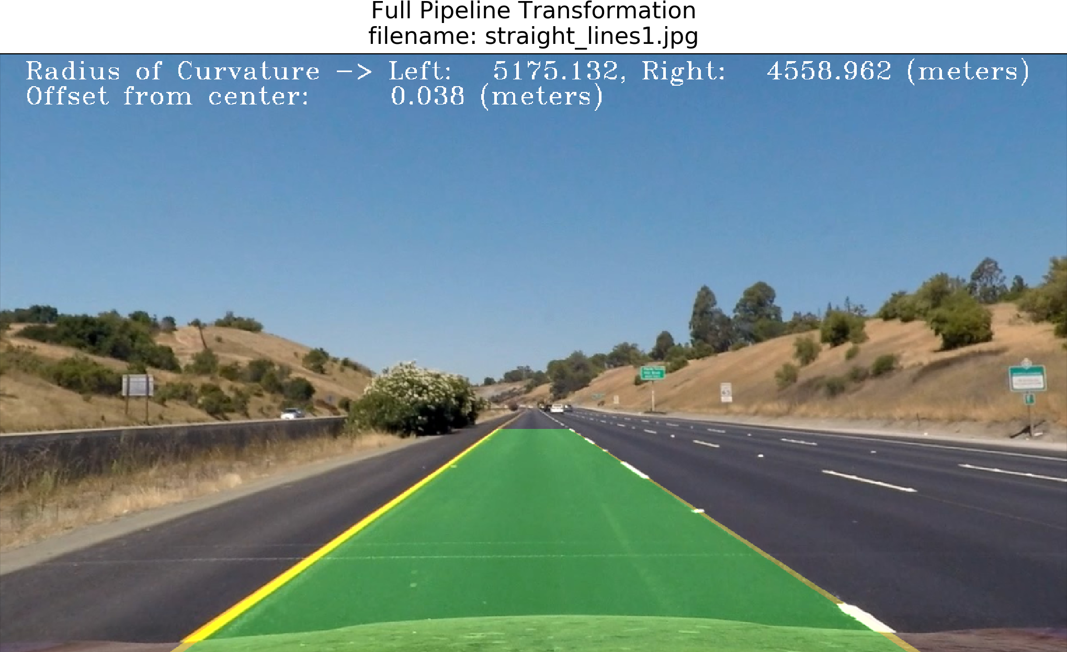
Full Pipeline (straight_lines1.jpg)

Slide 39


Video

Slide 40
Improvements
Finding a better combination of color channels.
Experimenting with other color spaces.
Experiment with the number of polynomials stored.
Weight the more recent polynomials more highly.

Slide 41
Questions

